Slide 1

Machine LEARNING Project

Slide 2
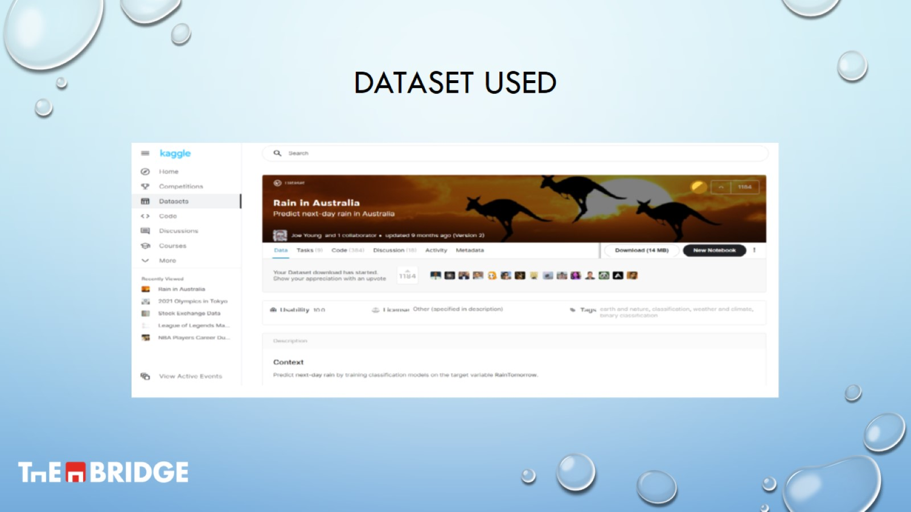
DATASET USED

Slide 3
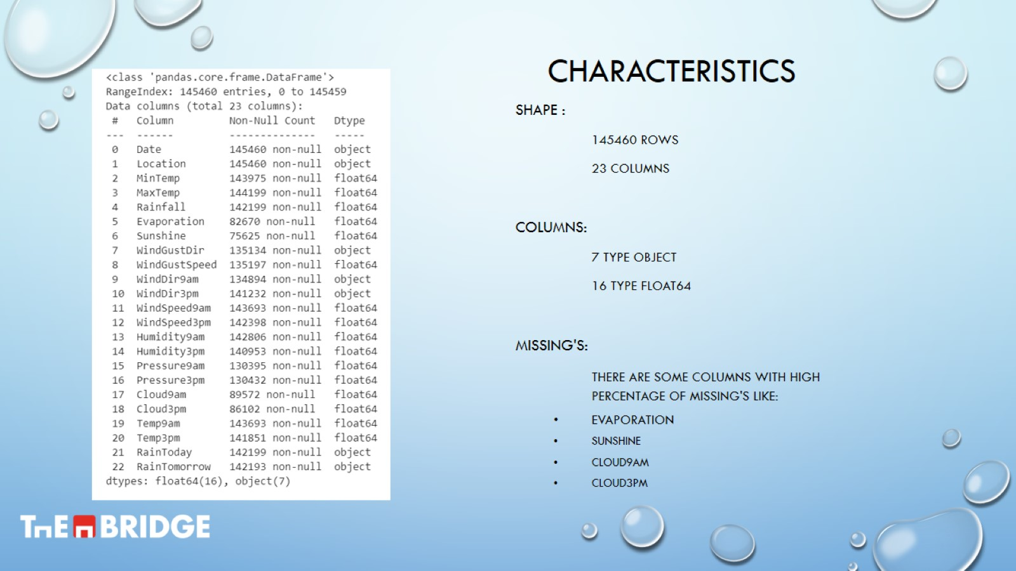
characteristics

Slide 4
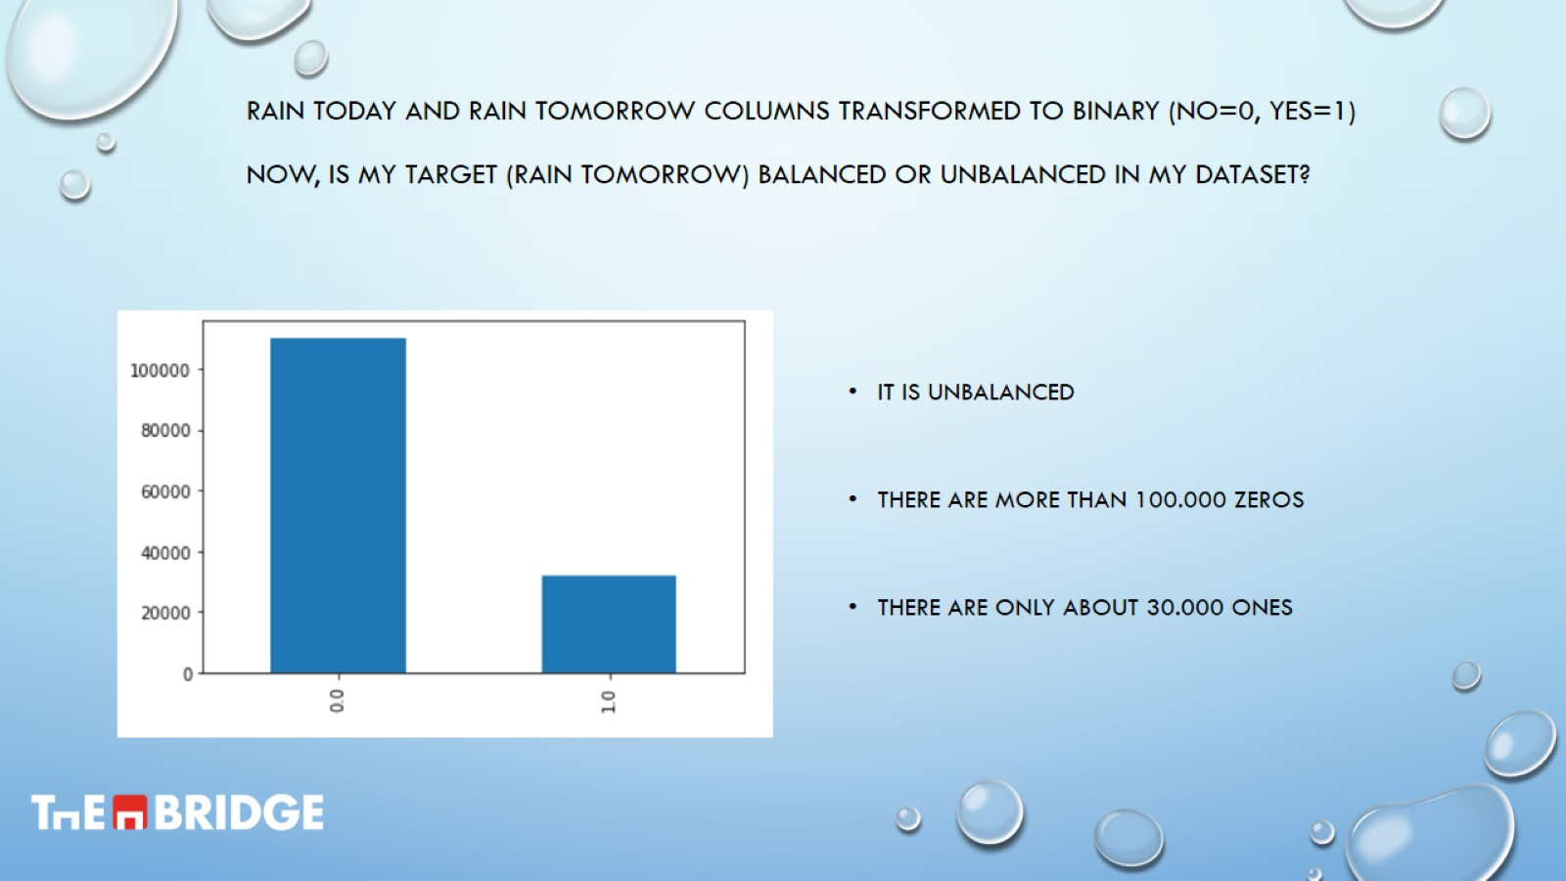
Rain today and rain tomorrow columns transformed to binary (no=0, yes=1) now, is my target (rain tomorrow) balanced or unbalanced in my dataset?

Slide 5
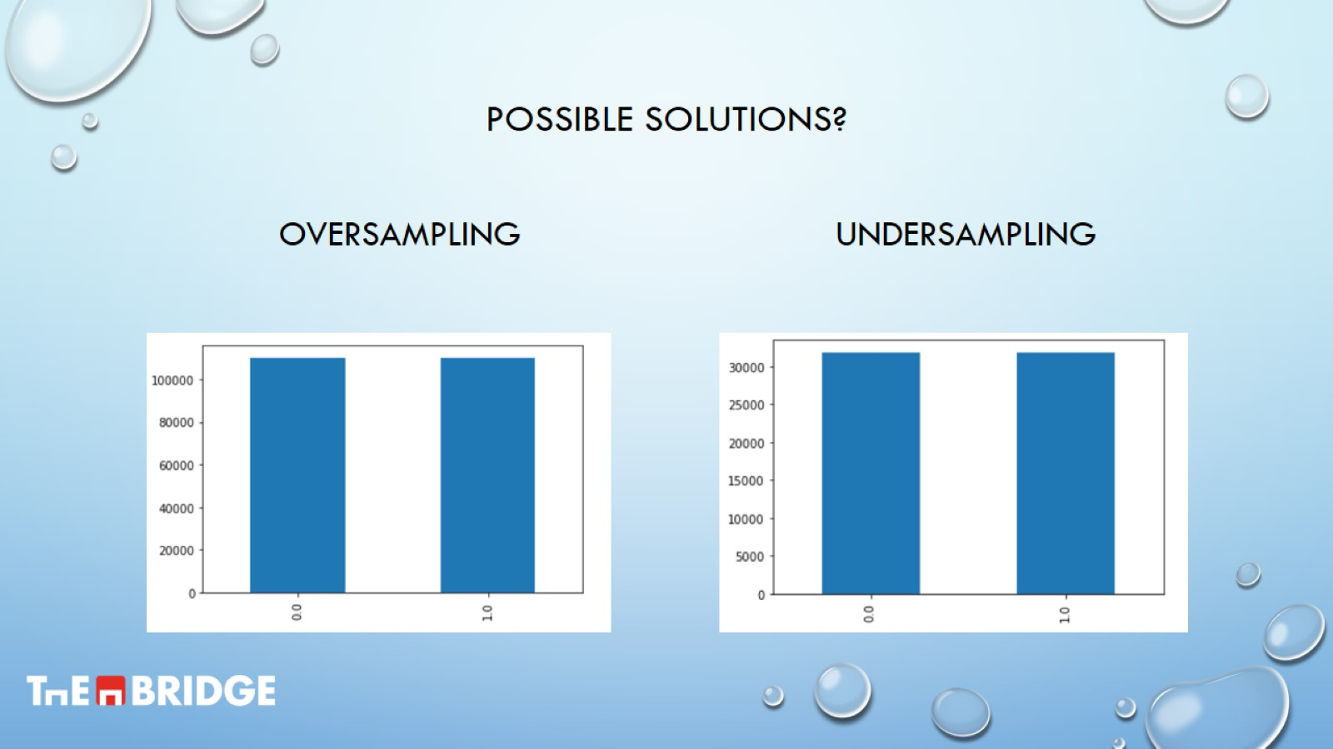
Possible solutions?

Slide 6
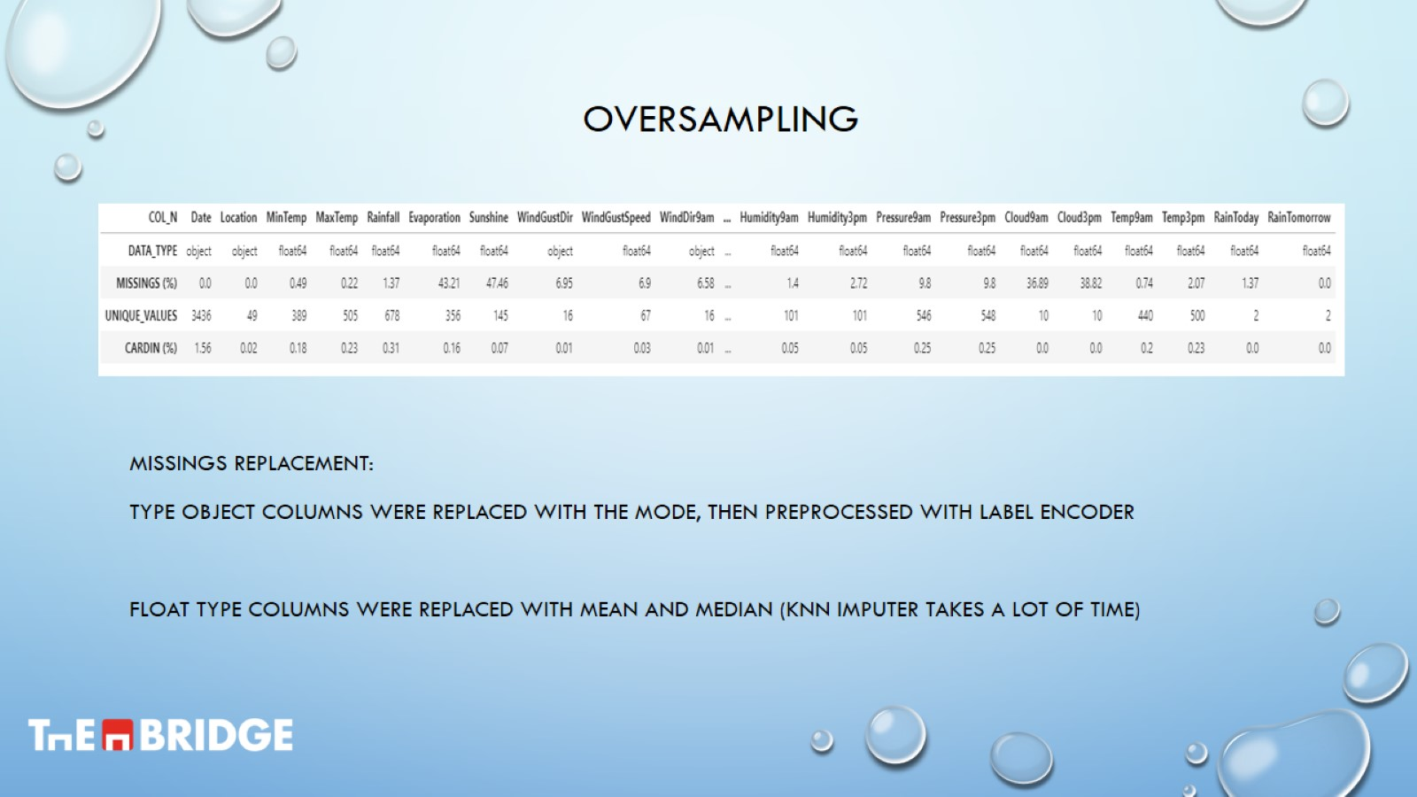
Oversampling

Slide 7
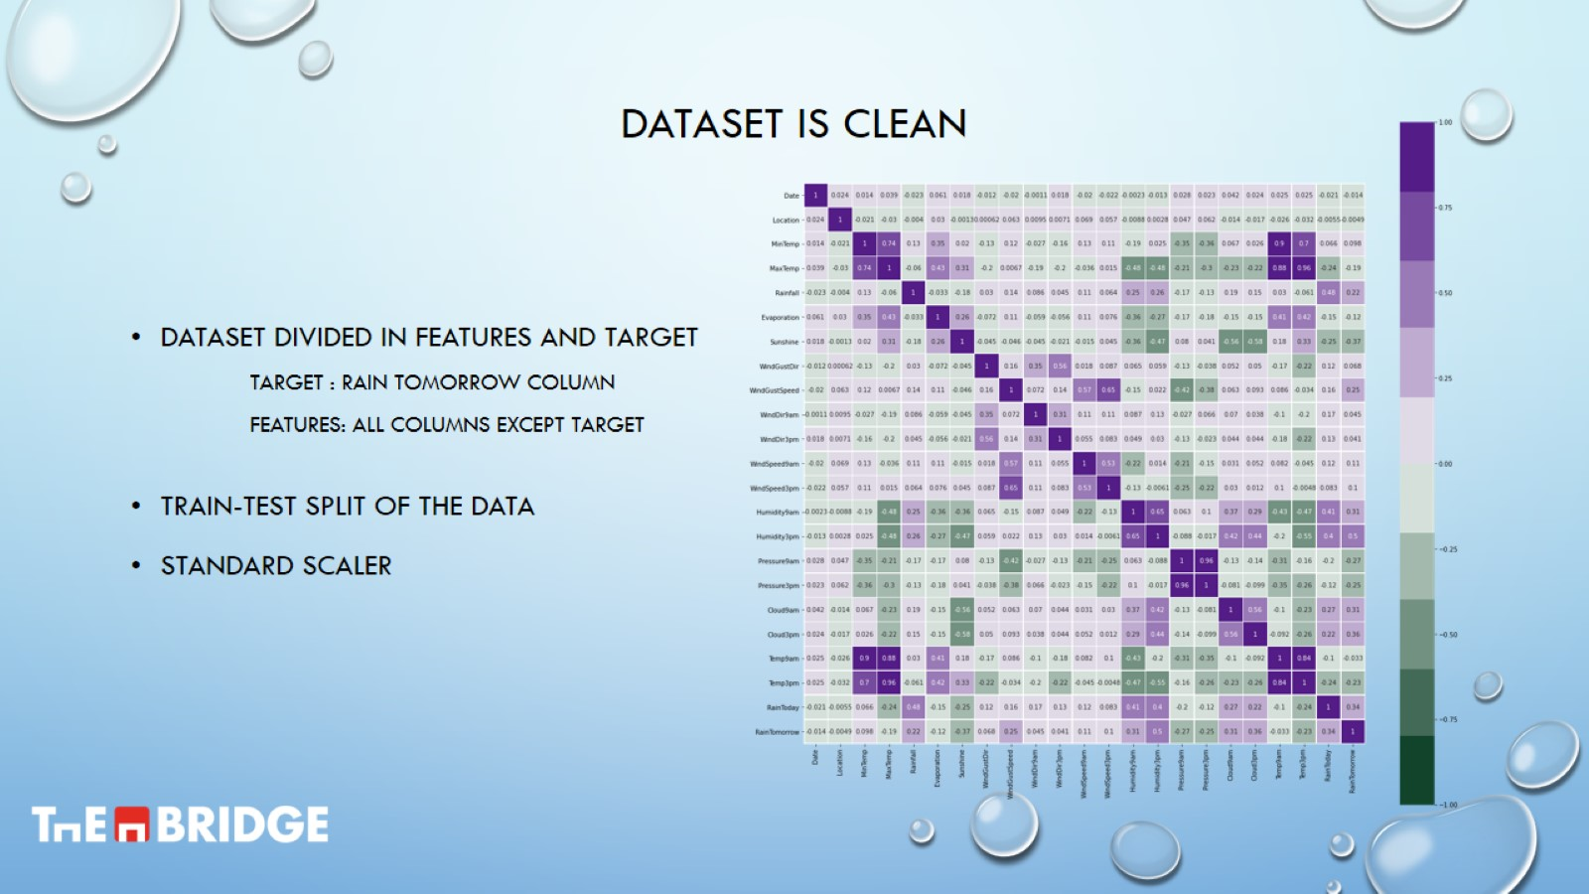
Dataset is clean

Slide 8
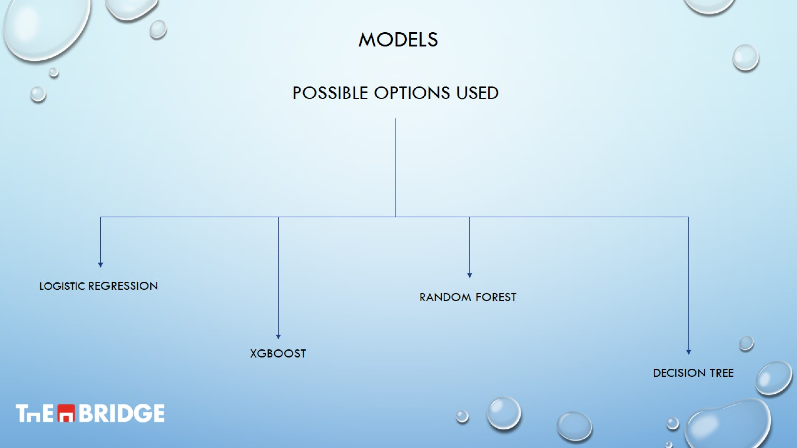
models

Slide 9
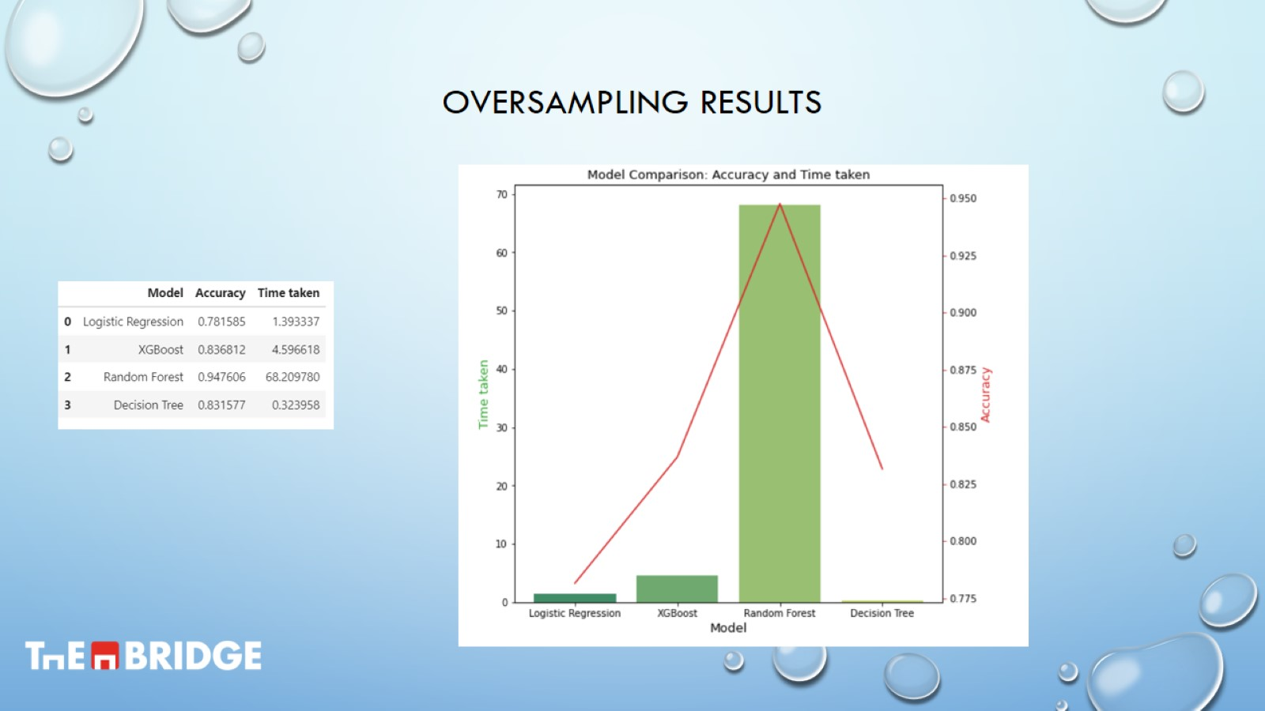
Oversampling results

Slide 10
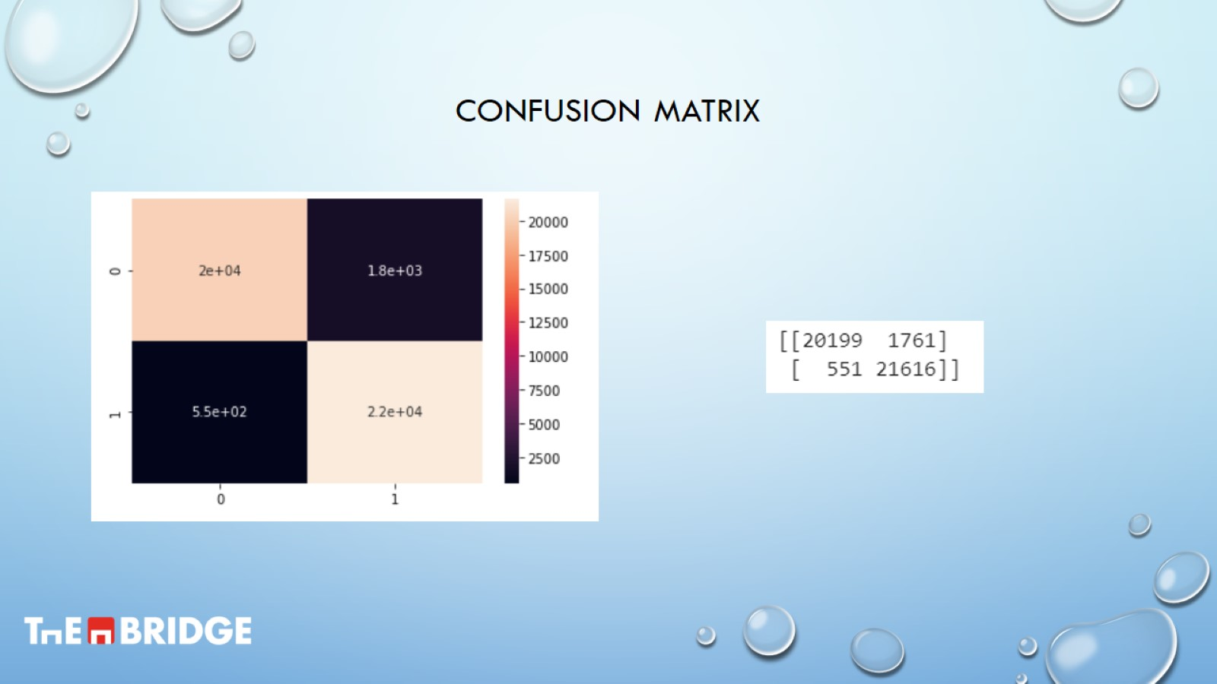
Confusion matrix

Slide 11
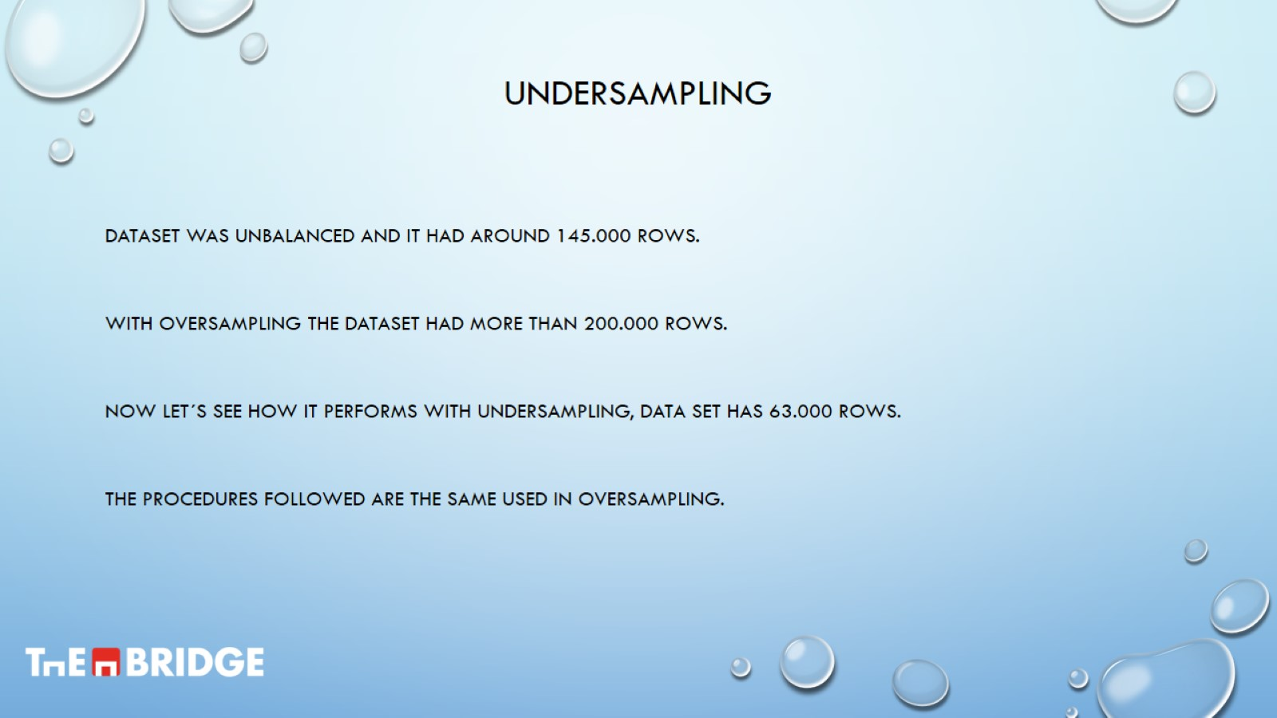
undersampling

Slide 12
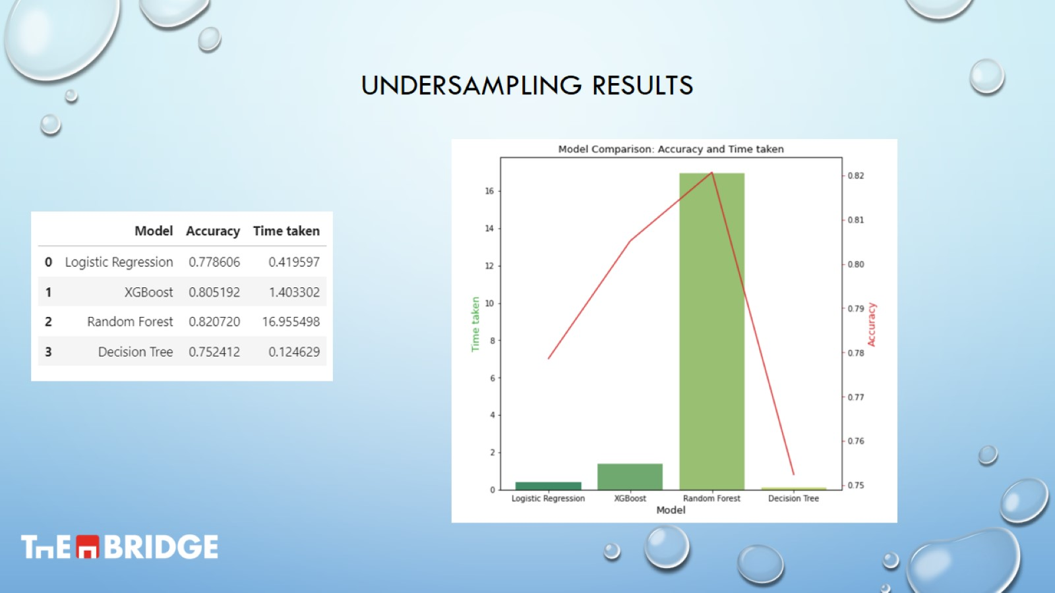
Undersampling results

Slide 13
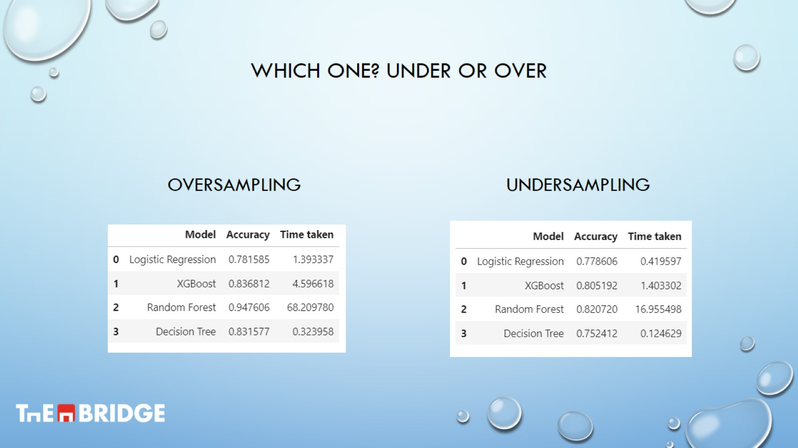
Which one? Under or over

Slide 14
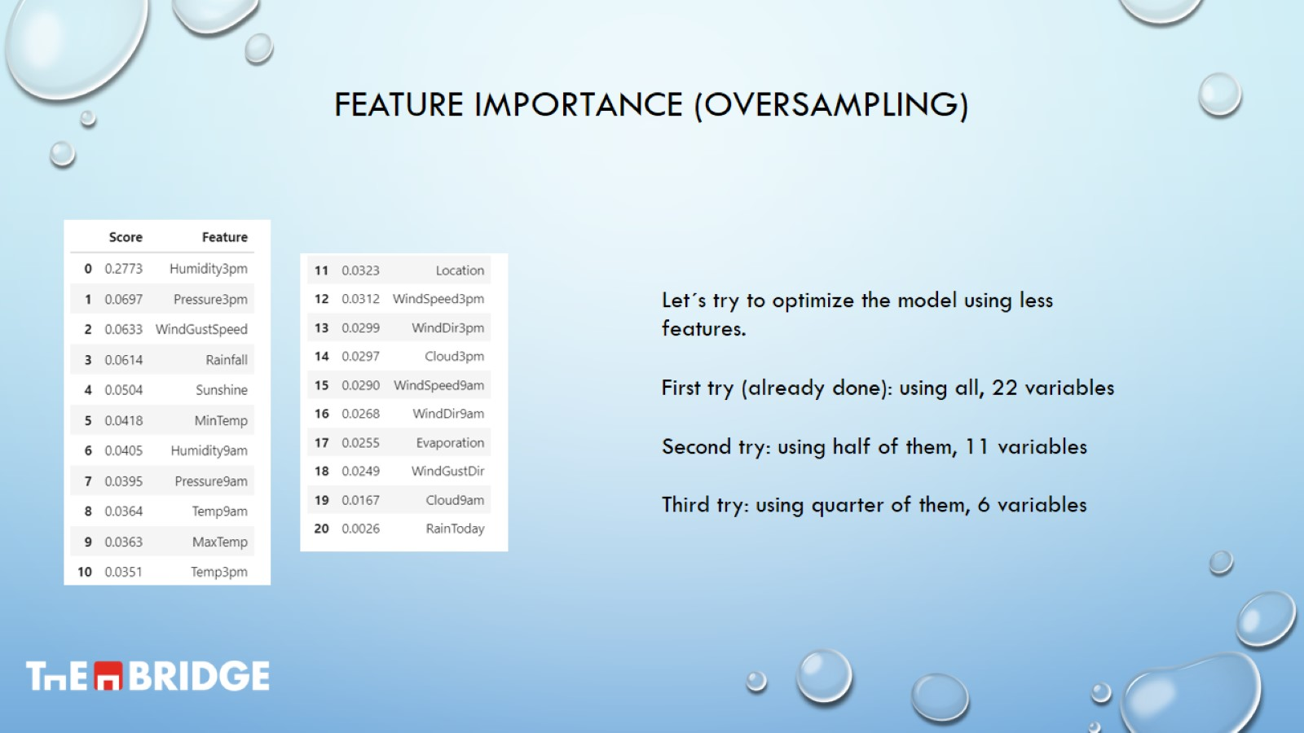
Feature importance (oversampling)

Slide 15
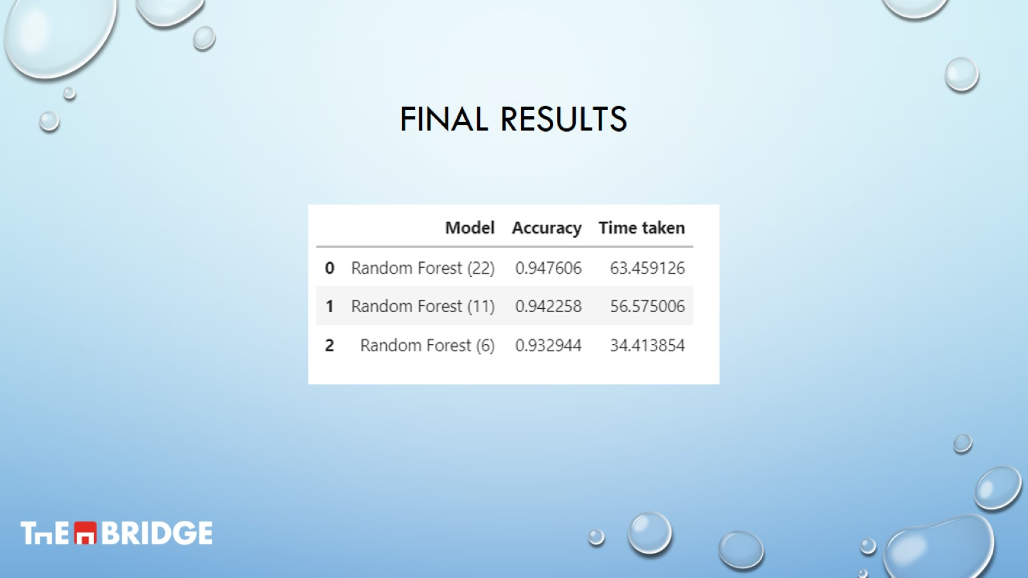
Final results

